Slide 1
School Finance for The Alabama Superintendent
June 2023
David Smith
AASBO

Slide 2
Superintendent’s Finance Training
Contracts/Purchasing
Superintendent and the CSFO
Understanding Your Financials
  LEA Financial Reports
  Audits of BOE’s
  Activity Funds/Parent Support Organizations

Slide 3
Contracts and Purchasing
Disclaimer: The opinions expressed in this presentation are those of David Smith and are not meant to be a legal interpretation of the law. The material included in this presentation is dated as of June 2023 and is subject to change.
This presentation:
    Is a general overview
    Cannot cover every situation
    Official interpretation of particular questions or situations should be obtained through the board’s legal counsel, the Examiners of Public Accounts, Alabama Attorney Generals Office, Alabama Ethics Commission or Alabama State Department of Education.

Slide 4
Contracts and Purchasing
This webinar discusses the expenditures of state and local funds. The expenditures of federal funds could be more restrictive under the Office of Management and Budget’s Uniform Administrative Requirements, Cost Principles and Audit Requirements – Part 200.
Please confer with your district CSFO on the procurement requirements for federal funds.

Slide 5
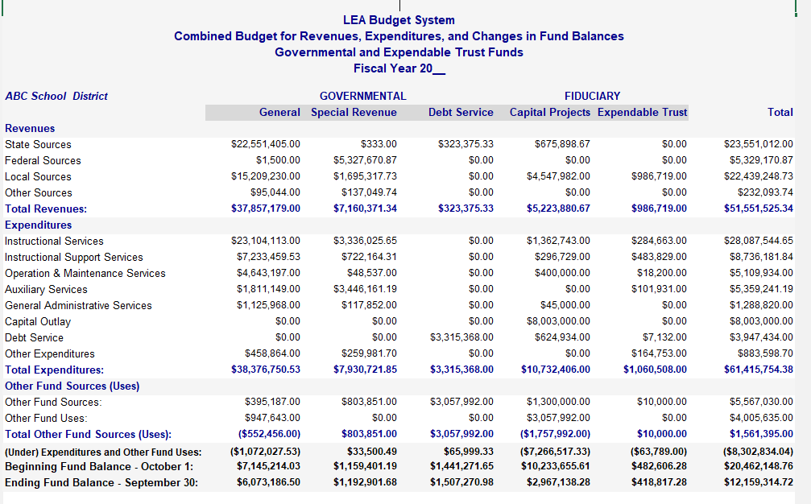

Slide 6
Regulation of Procurement for School Districts
The laws of most states regulate government procurement to some extent. Laws usually require the procuring authority to issue public bids if the value of the procurement exceeds a certain threshold.

Slide 7
Regulation of Procurement for School Districts
Alabama state law mandates very specific competitive purchasing procedures for expenditures over * $15,000 (note) and public work projects over $50,000 for school districts.
*Act 2023-203 in the 2023 Legislative Session increased the bid threshold in § 16-13B for the competitive bid law to $40,000 effective August 1, 2023

Slide 8
Alabama Competitive Bid Law
    § 16-13B-1, et seq. Ala. Code 1975
    Applies to County and City Boards of Education
    Applies to all expenditures of funds of whatever nature for labor, services, and work involving* $15,000 or more.
    Applies to all expenditures of funds for the purchase or lease of materials, equipment, supplies, or other personal property involving * $15,000 or more.
    *Act 2023-203 in the 2023 Legislative Session increased the bid threshold for the competitive bid law to $40,000 effective August 1, 2023.

Slide 9
Public Works Law
§ 39-2-1(6), Ala. Code 1975
PUBLIC WORKS- Applies to any construction, repair, renovation, or maintenance of public buildings, structures, sewers, waterworks, roads, bridges, docks, underpasses, and viaducts as well as any other improvement to be constructed, repaired, renovated, or maintained on public property and to be paid, in whole or part, with public funds or with financing to be retired with public funds in the form of lease payments or otherwise.

Slide 10
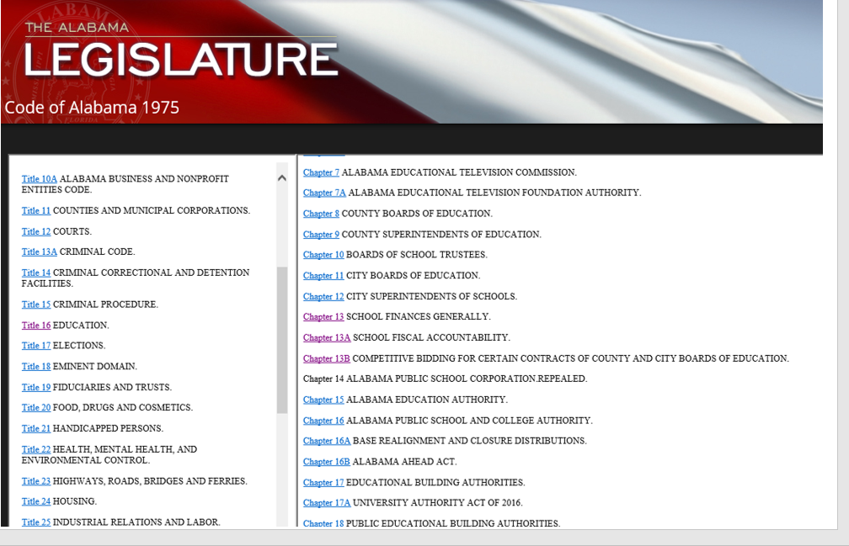
Alabama Competitive Bid Law

Slide 11
Title 16 EDUCATION Ala. Code 1975
Chapter 13B COMPETITIVE BIDDING FOR CERTAIN CONTRACTS OF COUNTY AND CITY BOARDS OF EDUCATION
§ 16-13B Ala. Code 1975
Section 16-13B-1 Applicability; local preference zone; joint agreement; bid bond.
Section 16-13B-2 Exceptions to competitive bidding requirements.
Section 16-13B-3 Emergency action.
Section 16-13B-4 Notice of proposed purchase; bids; reverse auction procedures.
Section 16-13B-5 Collusive agreements.
Section 16-13B-6 Advance disclosure of bid terms.
Section 16-13B-7 Defaulting bidder; award to second lowest responsible bidder; preferences; sole source specification; life cycle costs; rejection of bids; lease-purchase contracts.
Section 16-13B-8 Bond requirement.
Section 16-13B-9 Assignment of contract.
Section 16-13B-10 Conflict of interests; violations.
Section 16-13B-11 Action to enjoin execution of contract

Slide 12
Alabama Competitive Bid Law
Legal Authority- § 16-13B Ala. Code 1975
  Applies to County and City Boards of Education.
  Applies to the expenditure of funds for labor, services and work
  Applies to the purchase or lease of materials, equipment, supplies or other personal property
  Shall be made under contractual agreement entered into by free and open competitive bidding, on sealed bids, to the lowest responsible bidder.

Slide 13
Alabama Competitive Bid Law
Advertising Requirements- All proposed purchases in excess of fifteen thousand dollars *($15,000) shall be advertised by posting notice thereof on a bulletin board maintained outside the purchasing office and in any other manner and for any length of time as may be determined.
Sealed bids shall also be solicited by sending notice by mail or other electronic means to all person, firms, or corporations who have filed a request in writing that they be listed for solicitation on bids list for the particular items that are set forth in the request.
Must be sealed when received.
Opened in public at the hour stated in the notice.

Slide 14
Alabama Competitive Bid Law
§ 16-13B-4, Ala. Code 1975.
Bid Documents -All original bids together with all documents pertaining to the award of the contract shall be retained in accordance with a retention period of at least seven years established by the Local Government Records Commission and shall be open to public inspection.
Splitting of Contracts- No purchase or contract involving professional services shall be subject to the requirements of this chapter and no purchase or contract involving an amount in excess of fifteen thousand dollars ($15,000) shall be divided into parts involving amounts of fifteen thousand dollars ($15,000) or less for the purpose of avoiding the requirements of this chapter. All such partial contracts involving fifteen thousand dollars ($15,000) or less shall be void.

Slide 15
Items to be considered when determining the lowest RESPONSIBLE bidder…
(a) When purchases are required to be made through competitive bidding, awards shall be made to the lowest responsible bidder taking into consideration the:
Quality of the goods proposed to be supplied
Conformity with specifications
Purposes for which required
Terms of delivery
Transportation charges
Dates of delivery
    § 16-13B-7(a), Ala. Code 1975.

Slide 16
Length of Contract Terms
Section 16-13B-7 (f)
Contracts for the purchase of personal property or contractual services shall be let for periods not greater than five years. Lease-purchase contracts for capital improvements and repairs to real property shall be let for periods not greater than 10 years and all other lease-purchase contracts shall be let for periods not greater than 10 years.

Slide 17
Alabama Competitive Bid Law
    Awarding authority may reject a bid when the price is deemed excessive, or the quality of product is inferior.
    § 16-13B-7(d), Ala. Code 1975.
    Only One Bid Received
      May accept bid or
      May reject the bid and negotiate the purchase of the contract, provided the negotiated price is lower than the original bid price.
    § 16-13B-1(b), Ala. Code 1975

Slide 18
Joint Agreement
The governing bodies of two or more city or county boards of education, or any combination of two or more city or county boards of education, counties, municipalities, or instrumentalities thereof, may provide, by joint agreement, for the purchase of labor, services, or work, or for the purchase or lease of materials, equipment, supplies, or other personal property for use by their respective agencies.
Each governing body must approve joint purchasing agreement and details by resolution.
A Joint Purchasing Agent may be designated.
§ 16-13B-1(c )

Slide 19
Bid Process
Determination of goods or services that need to be bid.
Develop timeline/specifications.
Advertise and send bid packets to vendor list.
  Bid document/specifications, bid date, time and location.
Pre-bid conference
  Send out bid addendum if needed.
Accept sealed bids at date/time/ location as specified.
Open bids in public.
Evaluate bid to determine low responsible bidder.
Board approves bid/award contract.

Slide 20
Documentation of Results:
    To whom bid was awarded
    Reasons for not awarding to the lowest bidder (if applicable)
    Bid file shall be open for public inspection
    § 16-13B-7(e), Ala. Code 1975

Slide 21
Section 16-13B-2
Exceptions to competitive bidding requirements.
Section 16-13B-2
Exceptions to competitive bidding requirements.
(a) Competitive bids shall not be required for utility services for county or city boards of education, the rates for which are fixed by law, regulation, or ordinance, and the competitive bidding requirements of this chapter shall not apply to:
(1) The purchase of insurance.
(2) Contracts for securing services of attorneys, physicians, architects, teachers, superintendents of construction, artists, appraisers, engineers, consultants, certified public accountants, public accountants, or other individuals possessing a high degree of professional skill where the personality of the individual plays a decisive part.
(3) Contracts of employment in the regular civil service.
(4) Contracts for fiscal or financial advice or services.
(5) Purchases of products made or manufactured by the blind or visually handicapped under the direction or supervision of the Alabama Institute for Deaf and Blind in accordance with Sections 21-2-1 to 21-2-4, inclusive.

Slide 22
Section 16-13B-2
Exceptions to competitive bidding requirements.
Section 16-13B-2
Exceptions to competitive bidding requirements.
(6) Purchases of maps or photographs from any federal agency.
(7) Purchases of manuscripts, books, instructional materials, maps, pamphlets, or periodicals, or the electronic version thereof. The exemption for the purchase of instructional materials shall only include those purchases from a current vetted and approved list published by the State Department of Education.( Act 2022-80)
(8) The selection of paying agents and trustees for any security issued by a public body.
(9) Existing contracts up for renewal for sanitation or solid waste collection, recycling, or disposal and those providing the service.
(10) Purchases of computer and word processing hardware when the hardware is the only type that is compatible with hardware already owned by the entity taking bids and custom software.
(11) Contractual services and purchases of commodities for which there is only one vendor or supplier and contractual services and purchases of personal property which by their very nature are impossible to award by competitive bidding.
(12) Contractual services and purchases of products related to, or having an impact upon, security plans, procedures, assessments, measures, or systems, or the security or safety of persons, structures, facilities, or infrastructures.

Slide 23
2022 Legislation
    Act 2022-80
      “Purchases of manuscripts, books, instructional materials, maps, pamphlets, or periodicals, or the electronic version thereof. The exemption for the purchase of instructional materials shall only include those purchases from a current vetted and approved list published by the State Department of Education.” § 16-13B-2(a)(7), Ala. Code 1975.
    Act 2022-264
      Adds new provision to the bid law: § 16-13B-2.1, Ala. Code 1975. To authorize local BOE and other public educational entities to purchase goods or services related to Child Nutrition Program without advertising or bidding during an emergency or unanticipated event affecting public health or safety or causing supply chain disruptions, upon the recommendation of the state Superintendent of Education and approval of the Department of Public Accounts.

Slide 24
Section 16-13B-2
Exceptions to competitive bidding requirements.
(13) Purchases, leases, or lease/purchase of goods services, made as a part of any purchasing cooperative sponsored by the National Association of Counties, its successor organization, or any other national or regional governmental cooperative purchasing program. Such purchases, leases, or lease/purchase may only be made if all of the following occur:
a . The goods or services being purchased, including those purchased through a lease/purchase agreement, or leased are available as a result of a competitive bid process approved by the Department of Examiners of Public Accounts for each bid.
b. The goods or services are either not at the time available to local boards of education on the state purchasing program or are available at a price equal to or less than that on the state purchasing program.
c. The purchase, lease, or lease/purchase is made through a participating Alabama vendor holding an Alabama business license if such a vendor exists.

Slide 25
Section 16-13B-2
Exceptions to competitive bidding requirements
(14) Purchases of unprocessed agricultural products as defined in subsection (b) of Section 16-1-46 and the cost of the food purchased is equal to or less than the federal simplified acquisition threshold set in 2 C.F.R. §200.88.
(15) Purchase of goods or services, other than voice or data wireless communication services, from vendors that have been awarded a current and valid general services administration contract. Prices paid for the goods or services may not exceed the lowest competitively bid price for these goods or services, other than voice or data wireless communication services, and may not exceed the price on an existing state purchasing program.

Slide 26
Section 16-13B-2
Exceptions to competitive bidding requirements.
Section 16-13B-2
Exceptions to competitive bidding requirements.
(b) This chapter shall not apply to:
(1) Any purchases of products where the price of the products is already regulated and established by state law.
(2) Purchases made by individual schools of the county or municipal public-school systems from moneys other than those raised by taxation or received through appropriations from state or county sources.
(c) The city and county boards of education shall establish and maintain such purchasing facilities and procedures as may be necessary to carry out the intent and purpose of this chapter by complying with the requirements for competitive bidding in the operation and management of each city and county board of education.
(d) Contracts entered into in violation of this chapter shall be void, and anyone who violates this chapter shall be guilty of a Class C felony.

Slide 27
Emergencies
Section 16-13B-3
Must affect public health, safety or convenience, be declared in writing by the awarding authority, and such action and reasons should be immediately made public by the awarding authority.
Contracts may be let to the extent necessary to meet the emergency without public advertisement.
Must still follow other bid law requirements

Slide 28
Alabama Competitive Bid Law
When faced with questions- Seek advice
  Board’s Legal Council
  Examiners of Public Accounts
  Attorney General or Alabama Ethics Commission
  State Department of Education

Slide 29
Public Works Law

Slide 30
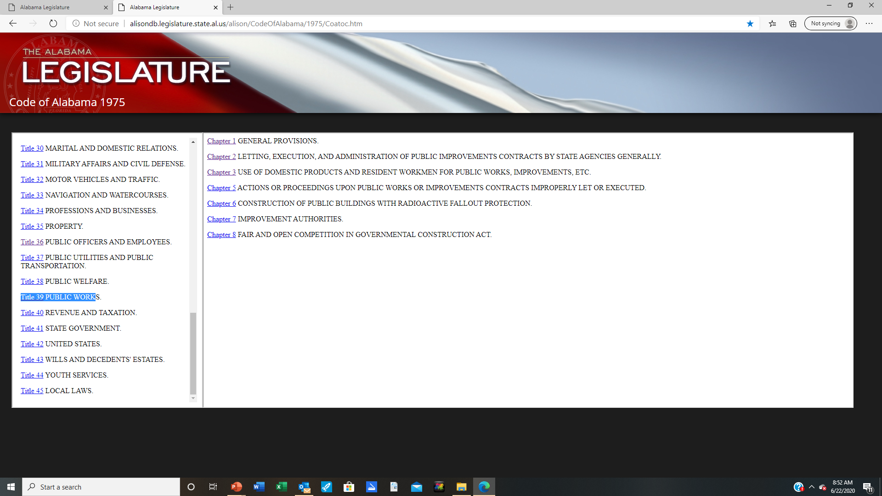

Slide 31
Public Works Law
Applies to any governmental board, commission, agency, body, authority, instrumentality, department, or subdivision of the state, its counties and municipalities.
§ 39-2-1(1), Ala. Code 1975
PUBLIC WORKS- Applies to any construction, repair, renovation, or maintenance of public buildings, structures, sewers, waterworks, roads, bridges, docks, underpasses, and viaducts as well as any other improvement to be constructed, repaired, renovated, or maintained on public property and to be paid, in whole or part, with public funds or with financing to be retired with public funds in the form of lease payments or otherwise.
§ 39-2-1(6), Ala. Code 1975

Slide 32
Expenditure Threshold
          § 39-2-2(a), Ala. Code 1975
            Before entering into any contract for a public works involving an amount in excess of fifty thousand dollars ($50,000), the awarding authority shall advertise for sealed bids…
            No public work…involving a sum in excess of $50,000 shall be split into parts involving sums of $50,000 or less for the purposes of evading the requirements of this section.”
      § 39-2-2(b), Ala. Code 1975
        An awarding authority may let contracts for public works involving fifty thousand dollars ($50,000) or less with or without advertising or sealed bids.”

Slide 33
Expenditure Threshold
          § 39-2-2(a), Ala. Code 1975
            Before entering into any contract for a public works involving an amount in excess of fifty thousand dollars ($50,000), the awarding authority shall advertise for sealed bids…
            No public work…involving a sum in excess of $50,000 shall be split into parts involving sums of $50,000 or less for the purposes of evading the requirements of this section.
      § 39-2-2(b), Ala. Code 1975
        An awarding authority may let contracts for public works involving fifty thousand dollars ($50,000) or less with or without advertising or sealed bids.

Slide 34

Bid Process

Slide 35
Planning
Project Planning
  Define Project (Capital Plan)
  Select Design Professionals
  Develop Educational Program/Project Design
  Develop Budget
  DCM Review/Approval Plans
  Bid Project
  Manage Project
  Post Assessment

Slide 36
Advertising Requirements
          § 39-2-2(a), Ala. Code 1975
            Public works involving an amount in excess of fifty thousand dollars ($50,000) shall advertise:
              Once a week for three consecutive weeks-newspaper of general circulation in the county or counties of the improvement is to be made.
              Additional requirement for contracts over $500,000-once in three newspapers of general circulation throughout the state.

Slide 37
Advertising Requirements
§ 39-2-2(a), Ala. Code 1975
The advertisements shall:
  briefly describe the improvement
  state that plans and specifications for the improvement are on file for examination in a designated office of the awarding authority
  state the procedure for obtaining plans and specifications
  state the time and place in which bids shall be received and opened and
  identify whether prequalification is required and where all written prequalification information is available for review.

Slide 38
Bid Lists
          § 39-2-2(a), Ala. Code 1975
            Sealed bids shall also be solicited by sending notice by mail to all persons who have filed a request in writing with the official designated by the awarding authority that they be listed for solicitation on bids for the public works contracts indicated in the request.

Slide 39
Award of Contract
§ 39-2-6
The contract shall be awarded to the lowest responsible and responsive bidder, unless the awarding authority finds that all the bids are unreasonable or that it is not to the interest of the awarding authority to accept any of the bids. A responsible bidder is one who, among other qualities determined necessary for performance, is competent, experienced, and financially able to perform the contract. A responsive bidder is one who submits a bid that complies with the terms and conditions of the invitation for bids.
Note- Act 2021-439 (§ 39-2-6 9 c )

Slide 40
Emergencies
          § 39-2-2(e), Ala. Code 1975
            In an emergency “affecting public health, safety, or convenience”, contracts may be let to the extent necessary to meet the emergency without advertisement. This is identical to the emergency provision in the competitive bid law, meaning that it is an exemption from advertising and not from competitively bidding the project.
              The emergency must be declared in writing by awarding authority, and must set forth the nature of the danger involved in delay and
              The action and reason shall immediately be made public by the awarding authority.

Slide 41
Public Works Work
Guidelines for capital projects:
  Any building or land improvement on a school district campus should be approved by the board of education.
  Board employee should be in charge of project.
  Must follow federal, state and local laws, building codes, procedures and guidelines.
  Should follow same process on all projects regardless of funding.
  By law, the Board has the authority to contract.
  Should have a contract review process in place for district and local school.

Slide 42
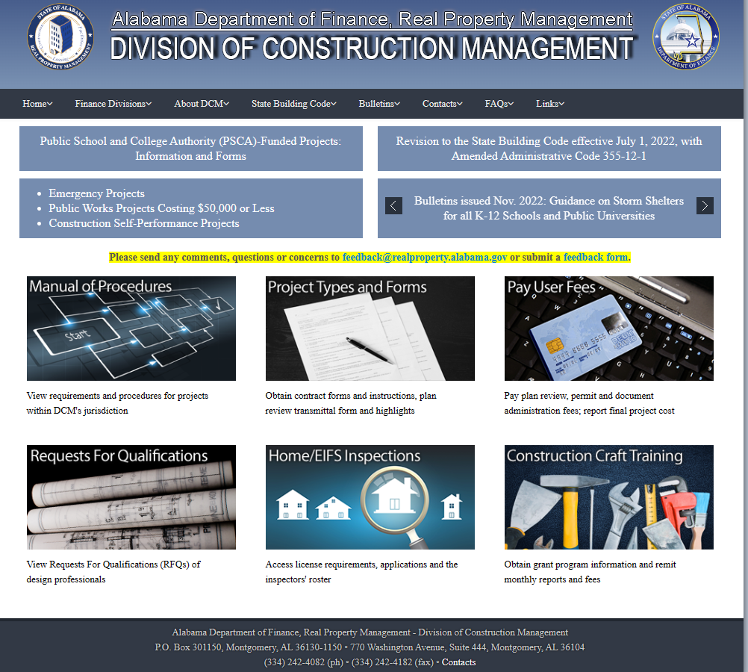

Slide 43
Public Works
Act - 2022-367
Division of Construction Management - Increases the threshold for projects not subject to approval by the Division of Construction Management from $500,000 to $750,000 including HVAC and roofing; requires LEAs to submit documents to the Division of Construction Management for the sole purpose of review and inspection for compliance with the American with Disabilities Act (ADA) and for fire and safety compliance.
Effective October 1, 2022

Slide 44

Self-Performed Work Projects
  Must comply with Division of Construction Management requirements:
    Full professional design team required.
    Plan review and approval required.
    Architect required to perform inspections.
    Division of Construction Management will conduct required inspections including Final Inspection.
    Compliance with Public Works Law or Competitive Bid Law will be applicable in most situations.
Notes:
44

Slide 45
Superintendent’s Academy
Contracts/Purchasing
June 2023
David Smith
david@aasbo.com

Slide 46
Credits
Discussion of the Alabama Competitive Bid Law and Public Works Law
Presented by Jason Paulk, Chief Legal Counsel
Department of Examiners of Public Accounts
May 2022 and September 2020
Procedures for Planning, Design and Construction of Public-School Projects
Alabama Division of Construction Management

Slide 47
Superintendent and the CSFO
School Fiscal Accountability Act
Role of Chief School Finance Officer (CSFO)
Expectations and Responsibilities

Slide 48
Superintendent and the CSFO
Hire a qualified person
Have an open line of communication
Involve the CSFO
Communicate your expectations
Ask questions

Slide 49
School Fiscal Accountability Act
Act No. 2006-196 created a new chapter in Title 16 of the Code of Alabama.
The purpose of this act is to clarify the fiscal responsibilities of the State Superintendent, local superintendents and chief school financial officers selected to carry out the fiscal responsibilities for local school boards and allow intervention for school boards found to be in an unsound financial condition.

Slide 50
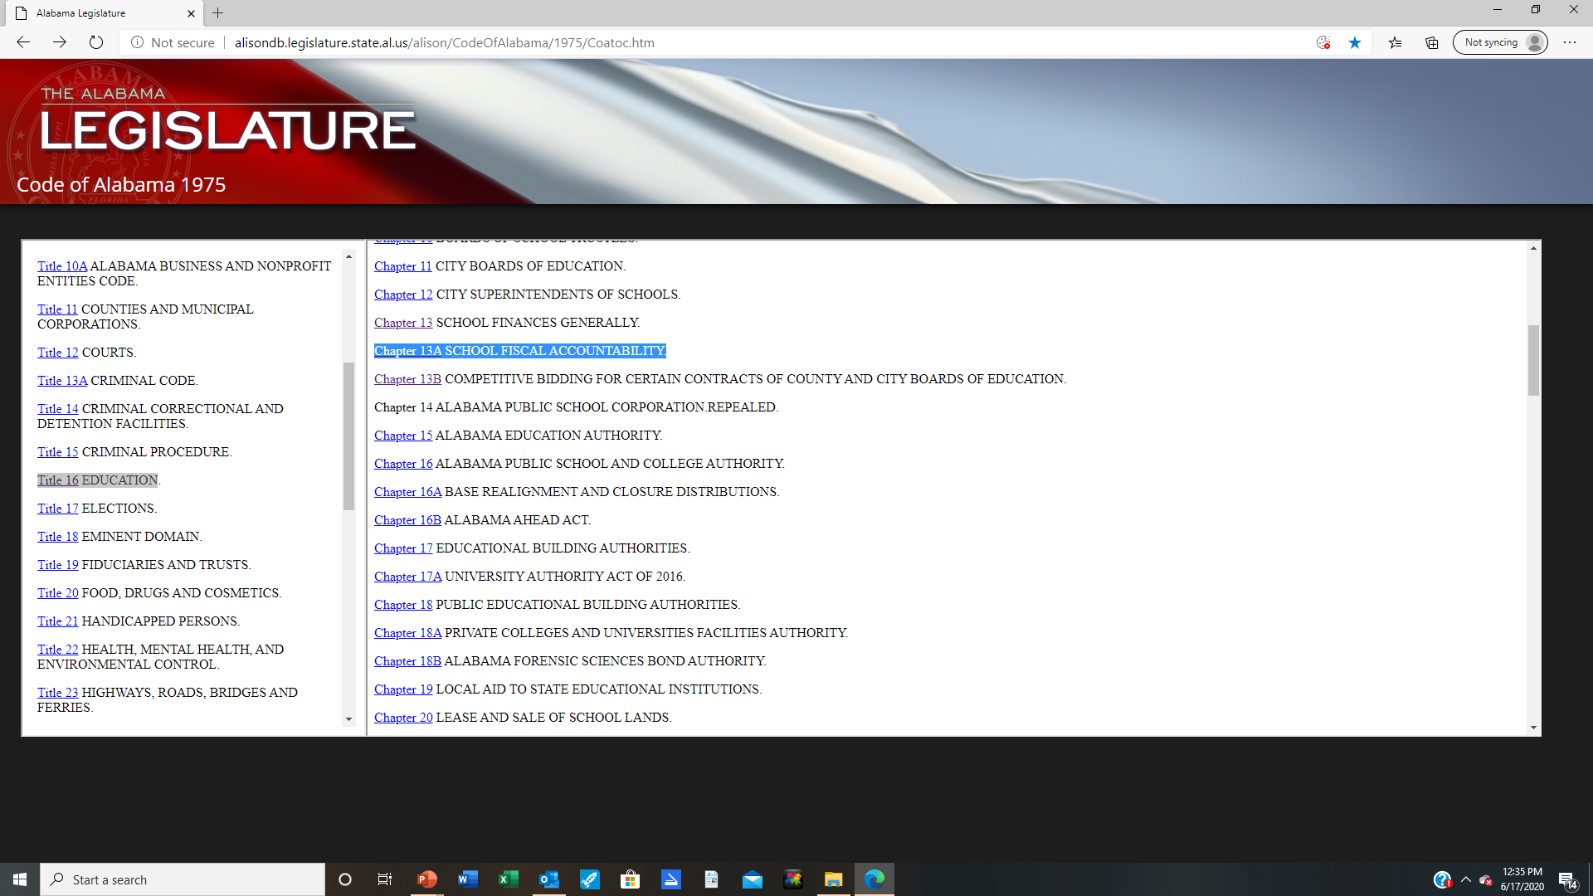

Slide 51
Chapter 13A SCHOOL FISCAL ACCOUNTABILITY
Section 16-13A-1 Fiscal management policies.
Section 16-13A-2 Financial oversight by State Superintendent of Education; appointment and duties of Chief Education Financial Officer; internal audits of schools and school systems.
Section 16-13A-3 Financial training of local superintendents of education.
Section 16-13A-4 Appointment; removal of chief school financial officer; qualifications.
Section 16-13A-5 Supervision, fiduciary responsibility of chief school financial officer; duties.
Section 16-13A-6 Required reports.
Section 16-13A-7 Audits.

Slide 52
Chapter 13A SCHOOL FISCAL ACCOUNTABILITY
Section 16-13A-8 Authority to expend funds.
Section 16-13A-9 Reserve funds.
Section 16-13A-10 Penalties for failing to comply with chapter.
Section 16-13A-11 Liability.
Section 16-13A-12 Bonding.
Section 16-13A-13 Publication of budget and financial information.

Slide 53
Chief School Financial Officer (CSFO)
Chief School Financial Officer - The chief financial officer should have overall responsibility for accounting and reporting all funds, including district and student activity funds, to the board. The chief financial officer is also responsible for implementing and enforcing appropriate internal control procedures.

Slide 54
Chief School Financial Officer (CSFO)
In consultation with the local superintendent, the local board will appoint a chief school financial officer who:
  Shall be an employee of the local board.
  Meet minimum qualifications of the local board.
  Meet the requirements established by the State Board of Education.
  Be bonded in an amount determined by the State.
The local board is authorized to remove the chief school financial officer
(Note SDE appointment)
§ 16-13A-4-, Ala. Code 1975

Slide 55
Chief School Financial Officer (CSFO)
Supervision, fiduciary responsibility of chief school financial officer; duties.
  (a) The chief school financial officer shall work under the direct supervision of the local superintendent of education but shall have a fiduciary responsibility to the local board of education.
§ 16-13A-5 (a) Code of Alabama

Slide 56
Chief School Financial Officer (CSFO)
§16-13A-5 (b)
(b) The chief school financial officer shall perform each of the following duties:
(1) Verify the receipt of all funds to which the local board of education may be entitled by law, or which may come into its possession for public school purposes.
(2) Verify the payment of such funds, such payments to occur only on written order of the local superintendent of education.
3) Keep an accurate record of all receipts and expenditures and provide such information to the local superintendent and the local board.
4) Make reports as may be required by law, by the local board of education, or by rules and regulations of the State Board of Education.

Slide 57
Chief School Financial Officer (CSFO)
§ 16-13A-5 (b)
5) Personally notify, in writing, each board member and the local superintendent of education of any financial transaction of the local board of education which the chief school financial officer deems to be non-routine, unusual, without legal authorization, or not in compliance with the fiscal management policies of the board. The notification shall be recorded in the minutes of the board by the president of the local board of education.
(6) Be bonded in an amount determined by the State Board of Education.

Slide 58
Rules of the State Board of Education
Rule 290-2-5 – Chief School Finance Officer
290-2-5-.01 Standards for Chief School Finance Officers
290-2-5-.02 Duties and Responsibilities of Chief School Finance Officers
290-2-5-.03 Qualifications for Chief School Finance Officers
290-2-5-.04 Certification of Chief School Finance Officers
290-2-5-.05 Performance Standards for Chief School Finance Officers
290-2-5-.06 Requirements to Continue Certification as a Chief School Finance Officer
http://www.alabamaadministrativecode.state.al.us/docs/ed/index.html

Slide 59
Role of CSFO
Areas of Responsibility
  Budgeting
  Accounting/Finance
  Purchasing
  Risk Management
  Food Service Program
  Operations/Maintenance/Transportation
  Capital/Facilities

Slide 60
Role of CSFO
One of the key positions in a school district's organization other than the superintendent is the CSFO.
The role of the CSFO is one of the most demanding and difficult positions in the school district’s organization. Each district is encouraged to require/ provide training for key finance personnel.
A Qualified CSFO should be one of highest compensated employees in the district.
  You get what you pay for.
  Hire based on qualifications and experience.
  Should be part of district’s executive staff.
  Works on contract like superintendent (Exempt from Students First Act)

Slide 61
Expectations
Accurate financial information provided in timely manner
  Monthly/Annual Financials
  Budget Analysis
  Financial Forecast
Information on how $ are being spent
Operational Efficiency
Long Range Financial Planning
Financial Compliance

Slide 62
CSFO Relationship with Superintendent
Communication
  Monthly Review of Finances
    Must have open line of communication
  Work Sessions
    Semi Annual Budget Reviews
  Sub Committees of Board
    Audit/Finance
    Capital

Slide 63
CSFO Relationship with Superintendent
CSFO must be involved in decision making process
  Instructional Program/Staffing
  Operations/Capital/Technology
Needs to be part of the management team

Slide 64
All departments and programs must be involved in financial operations
Superintendent / Board
Personnel /
Pupil Services
Instruction
Transportation
Federal Programs
CNP
CSFO
Technology
Special Programs
Special Education
Vocational
Local Schools
Maintenance & Operations

Slide 65
Superintendent and the CSFO
Hire qualified staff
Have an open line of communication
Involve the CSFO
Communicate your expectations
Ask questions
Questions??????

Slide 66
Understanding Your School District’s Finances
District Financials
Audits
Local School Activity Funds
Parent Support Organizations

Slide 67
Understanding Your School District’s Finances
As Superintendent you must understand the financial operations of your system.

Slide 68
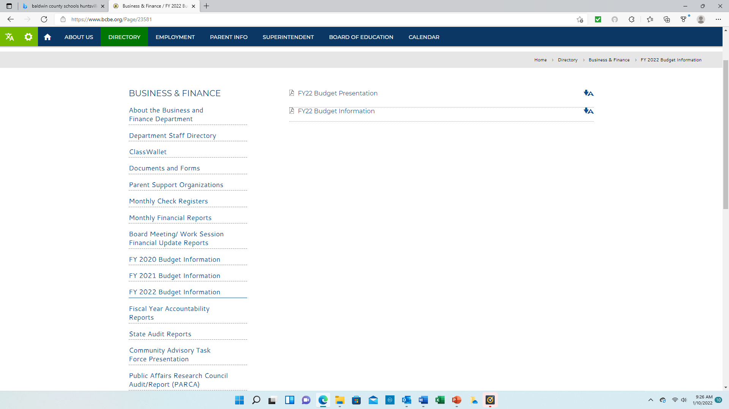

Slide 69
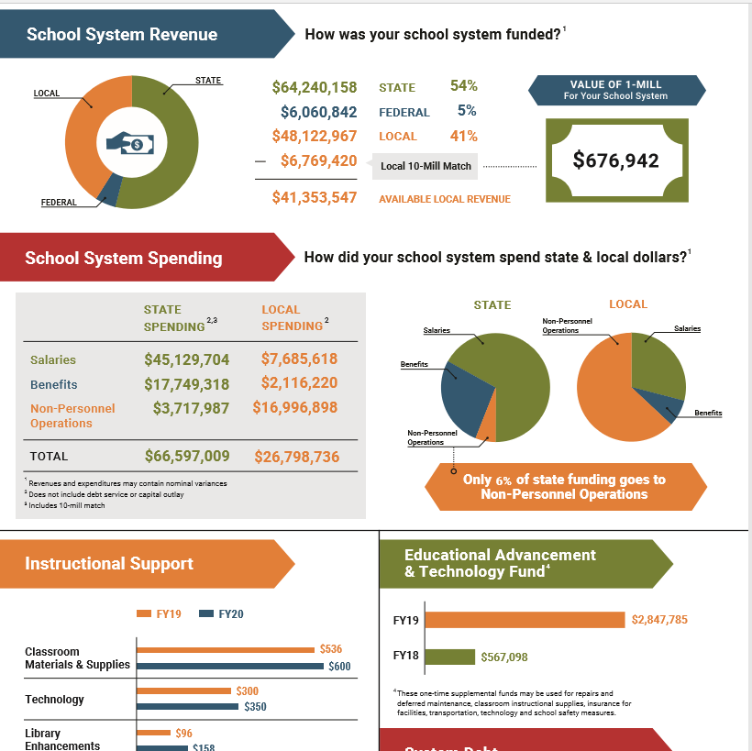

Slide 70
Chapter 13A SCHOOL FISCAL ACCOUNTABILITY
Code of Alabama 1975
Section 16-13A-1 Fiscal management policies.
Section 16-13A-2 Financial oversight by State Superintendent of Education; appointment and duties of Chief Education Financial Officer; internal audits of schools and school systems.
Section 16-13A-3 Financial training of local superintendents of education.
Section 16-13A-4 Appointment; removal of chief school financial officer; qualifications.
Section 16-13A-5 Supervision, fiduciary responsibility of chief school financial officer; duties.
Section 16-13A-6 Required reports.
Section 16-13A-7 Audits.
Section 16-13A-8 Authority to expend funds.
Section 16-13A-9 Reserve funds.

Slide 71
Section 16-13A-6
Required Reports
(a) The State Board of Education shall by regulation provide for various financial and other information which local superintendents of education shall have prepared for the local boards of education, including, but not limited to, the following:
(1) A monthly financial statement showing the financial status of the local board of education accounts with itemized categories specified by the State Board of Education.
(2) A monthly report showing all receipts and the sources thereof.
(3) A monthly report showing all expenditures with itemized categories specified by the State Board of Education.
(4) An annual projected budget.
(5) Monthly and/or quarterly reports showing expenditures relative to such projected budget.
(6) A yearly report of the fixed assets inventory of the local board of education with itemized categories specified by the State Board of Education.

Slide 72
Section 16-13A-6
Required Reports
(b) All local boards of education shall be required to implement a standardized financial accounting program as determined by the State Department of Education to collect the information required by this chapter and to provide for ease of input by local boards of education and ease of monitoring by a local board of education, its chief school financial officer, and the State Department of Education. If a local school system's financial report is found to be in conflict with generally accepted accounting principles, the State Department of Education shall issue a notice to that school system informing it of such and request that proof of correction of conflict be forwarded to the State Department of Education and approved by the State Superintendent of Education within a reasonable time thereafter.
(c) All financial documents, in whatever source maintained, are public documents, and shall be open to inspection and accessible to the public. An annual budget and monthly financial statements with supporting spread sheets as submitted to the State Department of Education shall be made available to the general public at the local school system Internet site.

Slide 73
Section 16-13A-6
Required Reports
  Required monthly reports must be posted to the local internet site no later than 45 days after the end of the reporting period.
  Budget Summary
  Exhibit F-I-A (Balance Sheet)
  Exhibit F-II-A (Financial Summary)
  Exhibit F-III-A (Budget Actual Comparison Part A)
  Exhibit F-III-B (Budget Actual Comparison Part B)
  Exhibit F-III-C (Budget Actual Comparison Part C)
From Accounting Software
  Accounts Payable Check Register Report

Slide 74
Financial Reporting
Annual Budget
Financial Statements
  Annual
  Monthly
Annual Audit
Other Required Financial Data

Slide 75
Annual Budget
§ 16-13-140
Established for county and city school systems; form of annual budget required; public hearings required
( a ) There shall be a budget system for the public schools of each county and city for the purpose of promoting economy and efficiency in the finances of the public schools.
(b) The State Department of Education shall prepare proposed annual budget forms for each local board of education.
( c ) Each board shall –
  Hold at least two open public hearings.
  Hearing held during a scheduled board meeting.
  At a time and place convenient for the public.
  The board shall publicize the date and time of each hearing in the local media.

Slide 76
Public Budget Hearings
In addition, notice of each hearing shall be posted in a conspicuous place at the offices of the local board of education, the county courthouse, the main municipal building, and at each affected school.
Recommend the proposed budget be available 24 to 48 hours prior to meeting.
Each board shall seek input from the public concerning the budget and allocation of resources.
After at least two public hearings, the board will develop a final budget and have copies available to the public.

Slide 77
Public Budget Hearings
The proposed budget shall reflect the total amount of resources available to the board from all funding and revenue sources.
The projected enrollment and the total proposed expenditure by each board and for each school shall be available at the public hearings.
The proposed budget shall clearly delineate the number of teachers, librarians, counselors, administrators and other support personnel projected to be employed at each school.
The proposed budget shall clearly list the operating costs by category or function at each school.
The proposed budget shall delineate by school those operating resources earned, including, but not necessarily limited to, those items contained in the Instructional Support Program of the Foundation Program, designating the amount of funds earned at each school per item based on average daily membership.

Slide 78
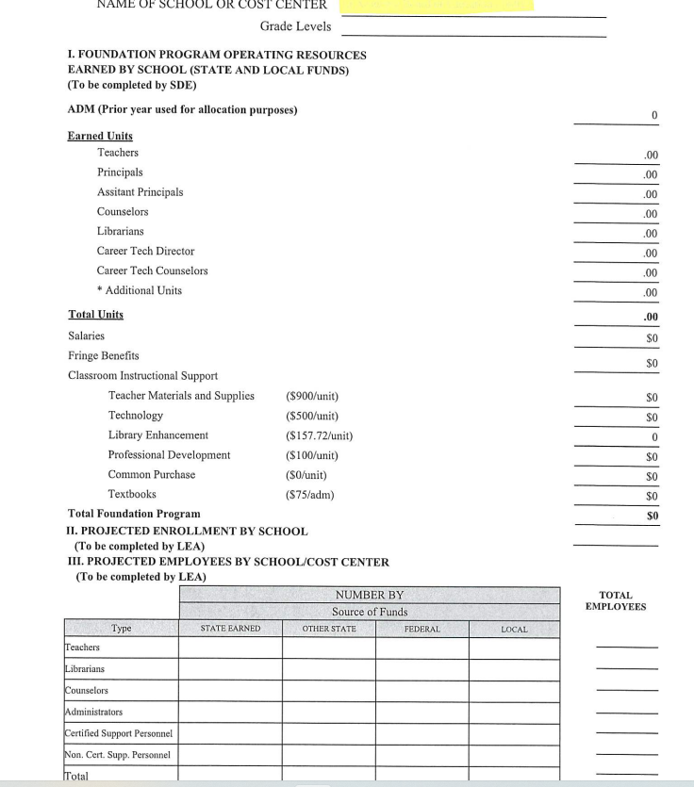

Slide 79
§ 16-13-140
Established for county and city school systems; form of annual budget required; public hearings required
(d) On or before October 1 of each year, each local board of education shall prepare and submit to the State Superintendent of Education the final annual budget adopted by the local board of education, which budget shall be prepared and submitted according to the classifications and items specified on forms provided therefor and in accordance with the regulations of the State Board of Education.
(e ) No local board of education, or superintendent thereof, shall approve any budget for operation of the school for any fiscal year which shall show expenditures in excess of income estimated to be available by the various state and other officials, as required in Sections 16-13-141 and 16-13-142, plus any balances on hand, except under conditions set forth by the laws of the state governing the issuance of school warrant.

Slide 80
Budget Amendments
A Budget Amendment is used to revise the working budget of a school district’s accounts to reflect changes that occur throughout the fiscal year.
Amendment of the original budget may be necessary to:
  Budget carryover funds for federal programs or new grants/programs.
  Significant changes to estimates for revenues, expenditures or fund balance.
Requires board approval
Final amendments due by June 15 to ALSDE

Slide 82
Fund Types
Governmental
General Fund – Accounts for most state and local funds of the district. Main operating fund that accounts for all financial resources of the school system except those required to be accounted for in another fund type.
Special Revenue Funds - Comprised of federal funds that have specific guidelines and limitations on the expenditure of these funds. Local school public funds are also included in this group.

Slide 83
Fund Types
Debt Service Fund- This fund reflects the annual debt payment (principal and interest) of the Board of Education on its outstanding debt.
Capital Projects Fund - Accounts for the financial resources used to acquire or construct major capital facilities.
Fiduciary Fund Type/Expendable Trust
Accounts for assets held by the school system in a trustee capacity for individuals, private organizations, other governmental units and/or other fund types (Non-Public).

Slide 84
Alabama School District Financials
SDE Financials
  Monthly financials are prepared on cash basis of accounting (most cases). Some are on a modified accrual.
  Annual financials are on modified accrual basis.
Audited Financials
  Prepared on full accrual basis
Both are prepared on fiscal year that is different from the scholastic year.
  Scholastic – July-June
  Fiscal- October- September

Slide 85
Monthly Financial Reports
Current Requirements
Required Monthly Reports
  Balance Sheet
  Income Statement
  Income Statement - Budget/Actual
  Accounts Payable Check Register
  Verification- Reconciliations of all bank accounts

Slide 86
Financial Statements
Required Monthly Financials
Fund Types
  Combined Balance Sheet
    All Fund Types and Account Groups
  Income Statement-
    Combined Statement of Revenues, Expenditures, and Changes in Fund Balances
  Income Statement- Budget and Actual
    Combined Statement of Revenues, Expenditures, and Changes in Fund Balances- Budget and Actual

Slide 87
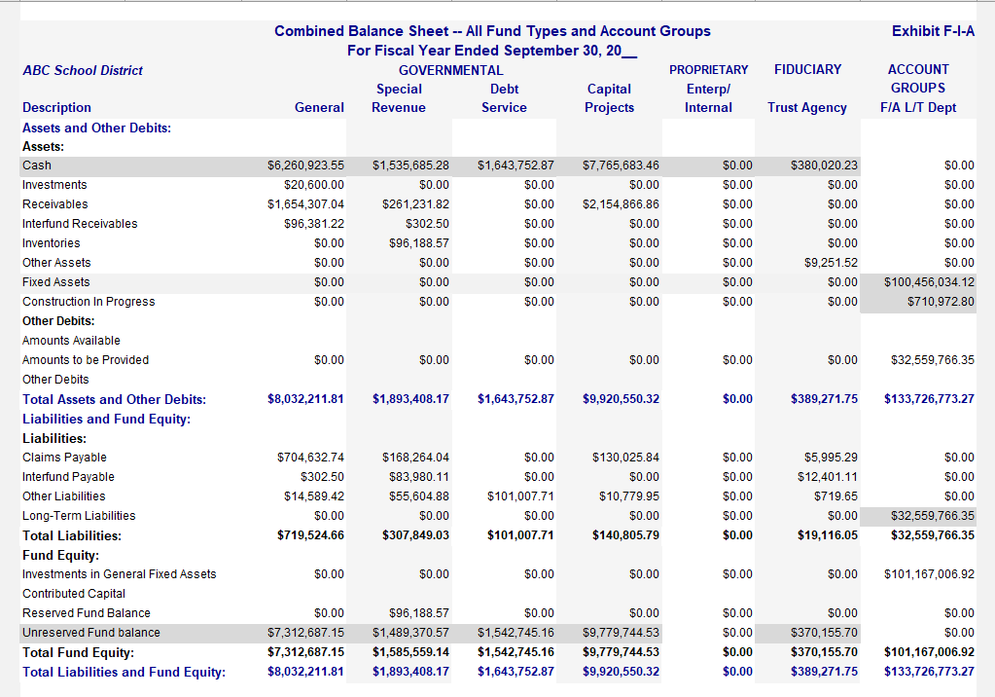

Slide 88
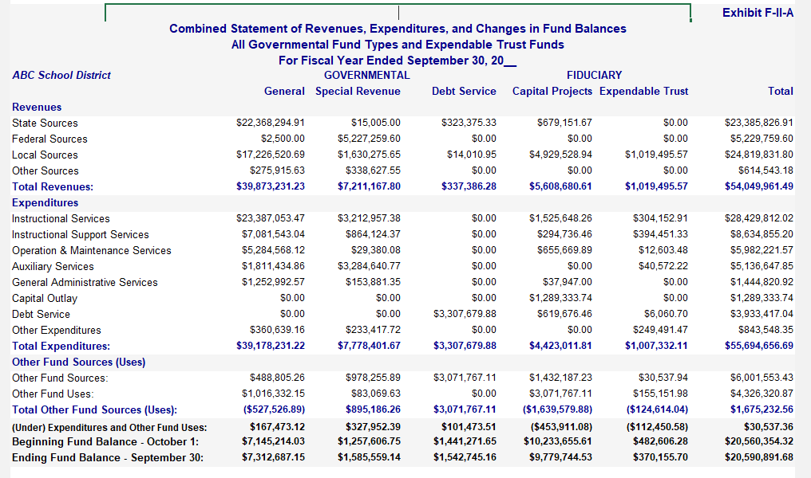

Slide 89
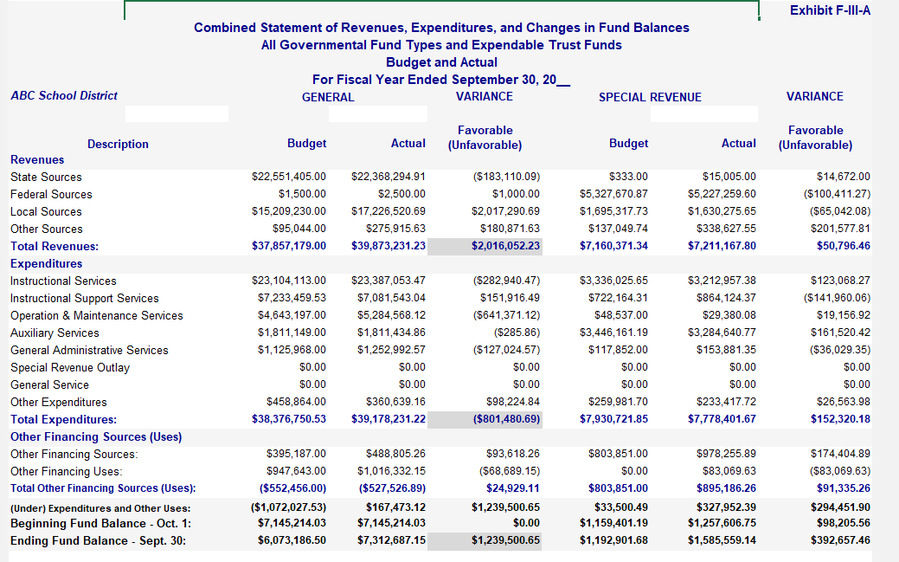

Slide 90


Slide 91
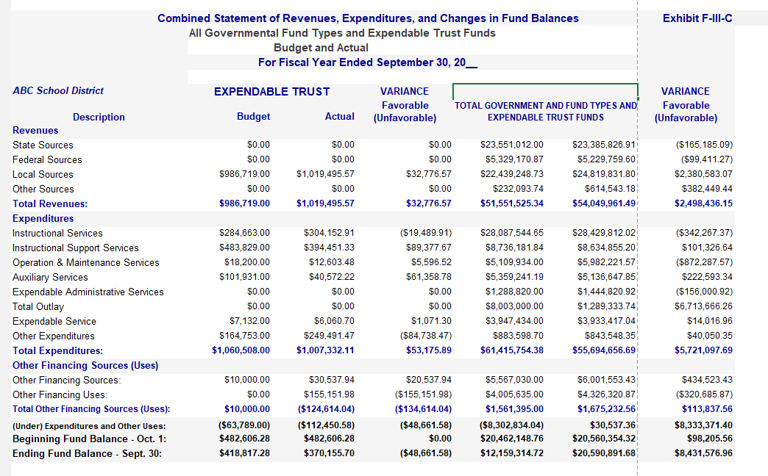

Slide 92
Recommended Financial Info for
Superintendent/Board
Required Financial Statements
  (F Exhibits)
Narrative with Financial Highlights
  Highlights the district’s financial operations and explains notable variances between budgeted and actual figures.
Supplemental Reports
  Summarized information for revenues/expenses and balance sheet
    Snapshot/Dashboard
    User friendly format - charts and graphs
Semi Annual- Budget Review
  Actual VS Budget
  Year end projections

Slide 93
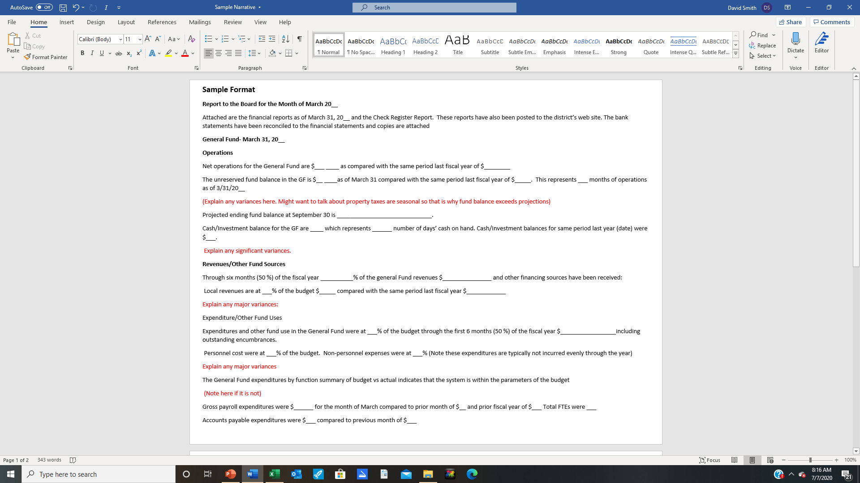

Slide 94
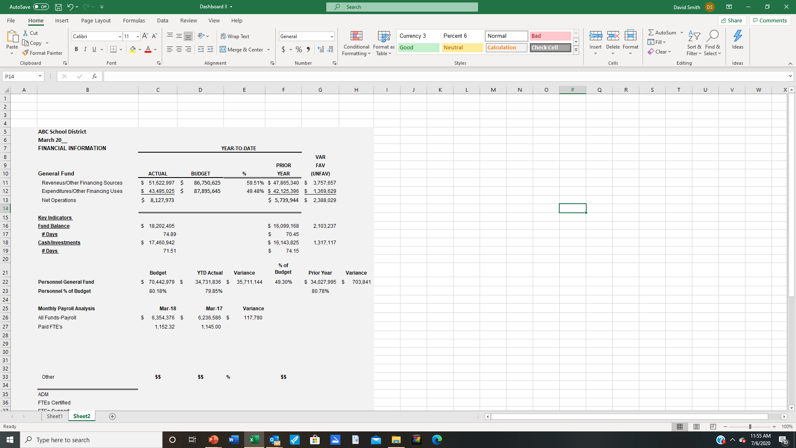

Slide 95
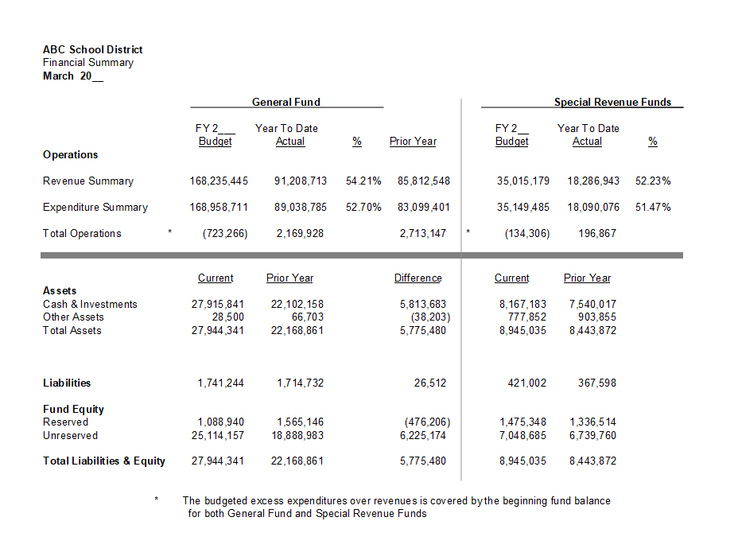

Slide 96
Key Financial Indicators
Enrollment
Financial Performance
Local Revenue Support
Personnel Cost
Efficiency of Operations
Economic Indicators

Slide 97
Financial Performance
Financial Trends
  3-5 Year History of Operations
    Net Operations
    Budget/Actual
    Fund Balance
    Cash Balance

Slide 98
What can you do…?
Understand your budget/finances and key indicators
Monitor performance against budget during the year
  Ask Questions
Evaluate financial performance
Plan and make necessary changes when needed

Slide 99
Understanding Your School District’s Finances
Review your 2022 SDE Financials
Review the Supplemental Schedules
Compare financial performance to budget
Review multi-year operations (3-4 years)
Review the districts' FTE Data for certified and support personnel
Review previous years audit reports

Slide 100
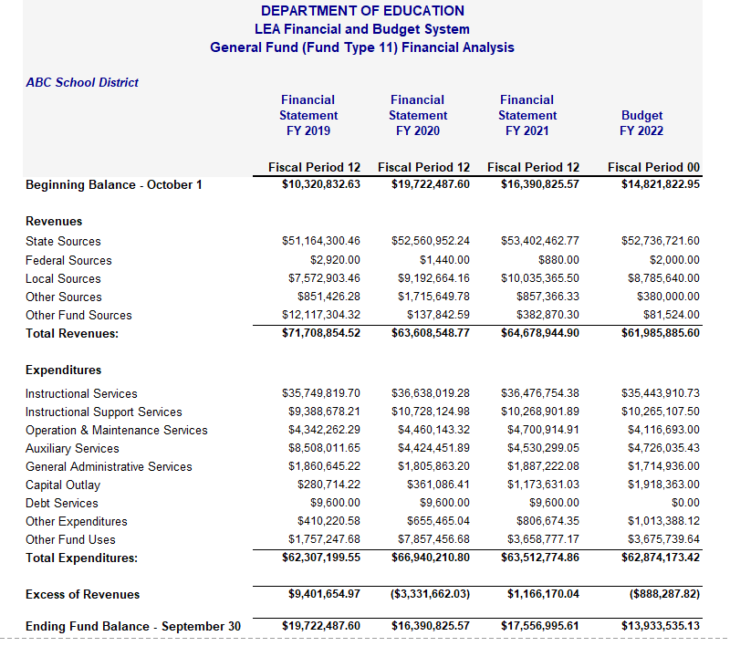

Slide 101
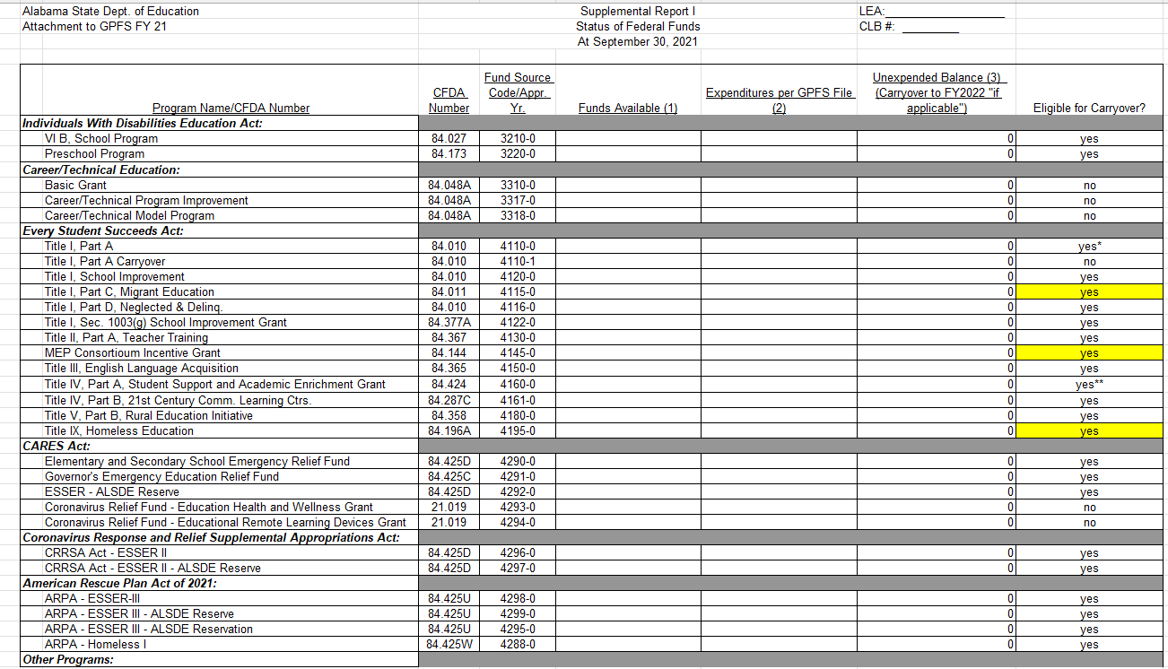

Slide 102
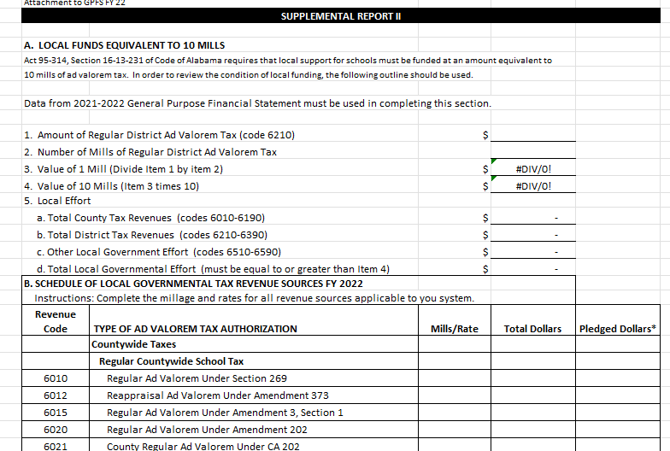

Slide 103
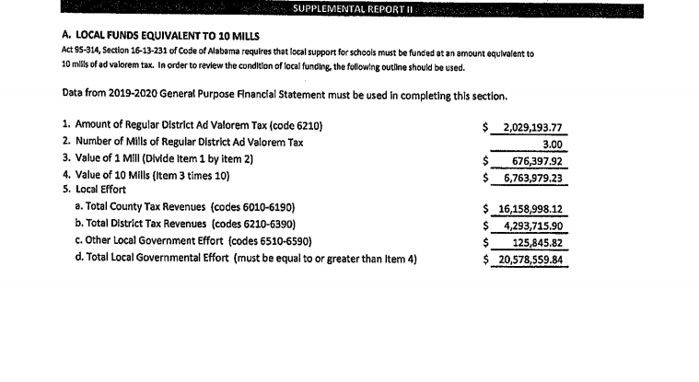

Slide 104
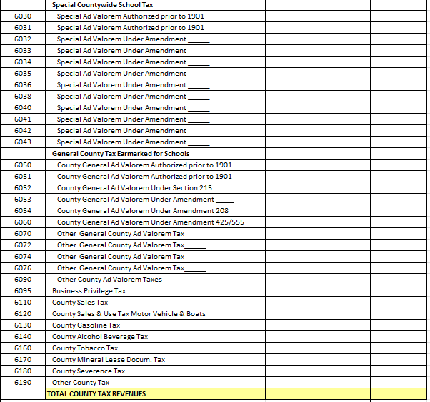

Slide 105
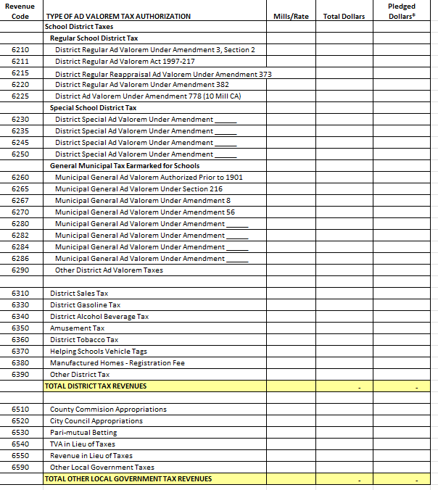

Slide 106
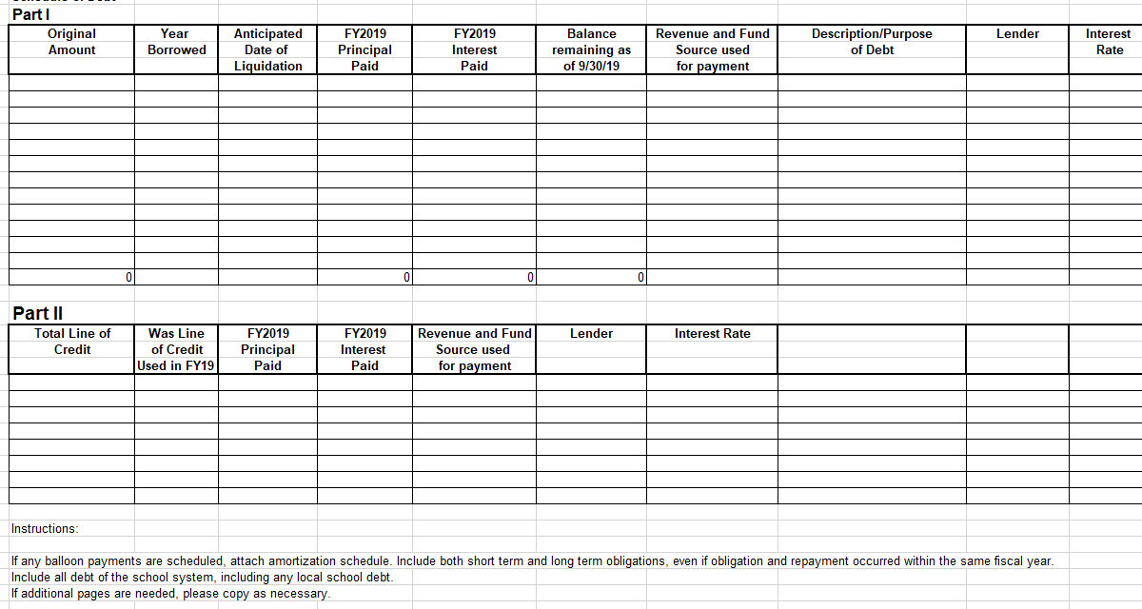
Schedule of Debt

Slide 107
Audits of Boards of Education
Section 16-13A-1 Fiscal management policies.
Section 16-13A-2 Financial oversight by State Superintendent of Education; appointment and duties of Chief Education Financial Officer; internal audits of schools and school systems.
Section 16-13A-3 Financial training of local superintendents of education.
Section 16-13A-4 Appointment; removal of chief school financial officer; qualifications.
Section 16-13A-5 Supervision, fiduciary responsibility of chief school financial officer; duties.
Section 16-13A-6 Required reports.
Section 16-13A-7 Audits.
Section 16-13A-8 Authority to expend funds.
Section 16-13A-9 Reserve funds.
Section 16-13A-10 Penalties for failing to comply with chapter.
Section 16-13A-11 Liability.
Section 16-13A-12 Bonding.
Section 16-13A-13 Publication of budget and financial information.

Slide 108
Audits of Boards of Education
Section 16-13A-7
Audits.
(a)(1) The yearly business and financial transactions of a local board of education shall be audited as early as possible after the end of the fiscal year.
(c) A local board of education may request an audit of system funds under control of the same local board by the Department of Examiners of Public Accounts whenever there is a permanent change in the position of local superintendent of education or chief school financial officer.
(d) A local board of education by majority vote may unilaterally request an audit of any school or school system account under control of the same local board by the Department of Examiners of Public Accounts, if the board deems such action is in the best interest of the school system.
(e) The findings of audits conducted pursuant to this section shall be presented to the local board of education in a board meeting. The State Superintendent of Education shall be sent a copy of the audit to review and shall be notified of the time, place, and location of the meeting at which the findings will be presented to the local board of education. Audits are public records.
(Act 2006-196, p. 275, §2.)

Slide 109
Audit Reports
The Audit Report from the Examiners or CPA firm is due to the SDE before June 30.
Reminder letters are sent to Superintendent’s at the end of May for systems that have not yet submitted finalized audit reports.
Review previous years audit report

Slide 110
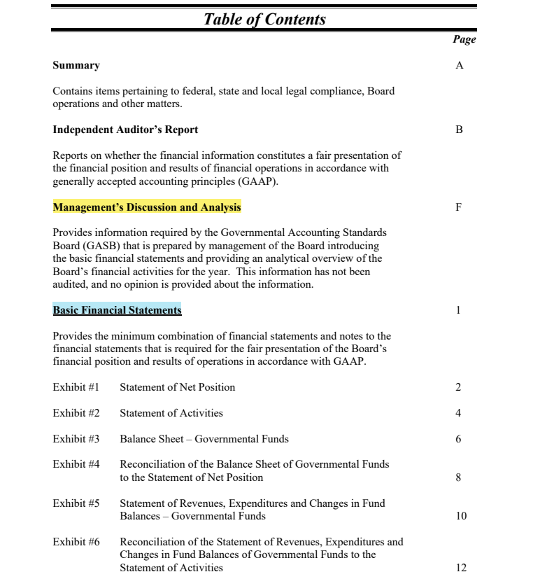

Slide 111
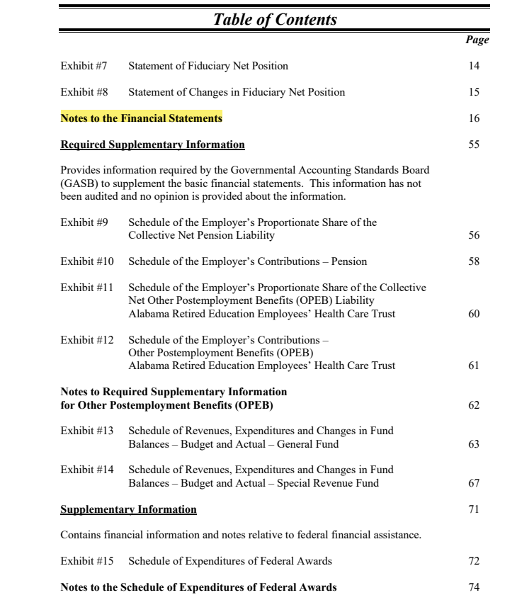

Slide 112
Management's Discussion and Analysis
MD&A
Prepared by management.
Summarizes the information contained in the statements.
Easy to read objective analysis of your district’s financial activity for the year.
  Highlight issues important to financial statement users.
Provides an analysis of the district’s overall financial position.
Helps assess if district’s financial position has improved or deteriorated.
Explains significant variations in financial results.
Description of known conditions that are expected to have impact on future financial position and operations.

Slide 113
Local School Finances
Historically, little attention has been given to accounting for activity funds in school districts. The nature of activity funds, however, makes them especially vulnerable to error, misuse, and fraud.
In addition, activity funds often total to large sums of money, especially when capturing the amounts that flow through an educational organization in the form of school board funds, student-generated funds, receipts and disbursements related to athletics, and the numerous co curricular and extracurricular events sponsored by school districts today.

Slide 114
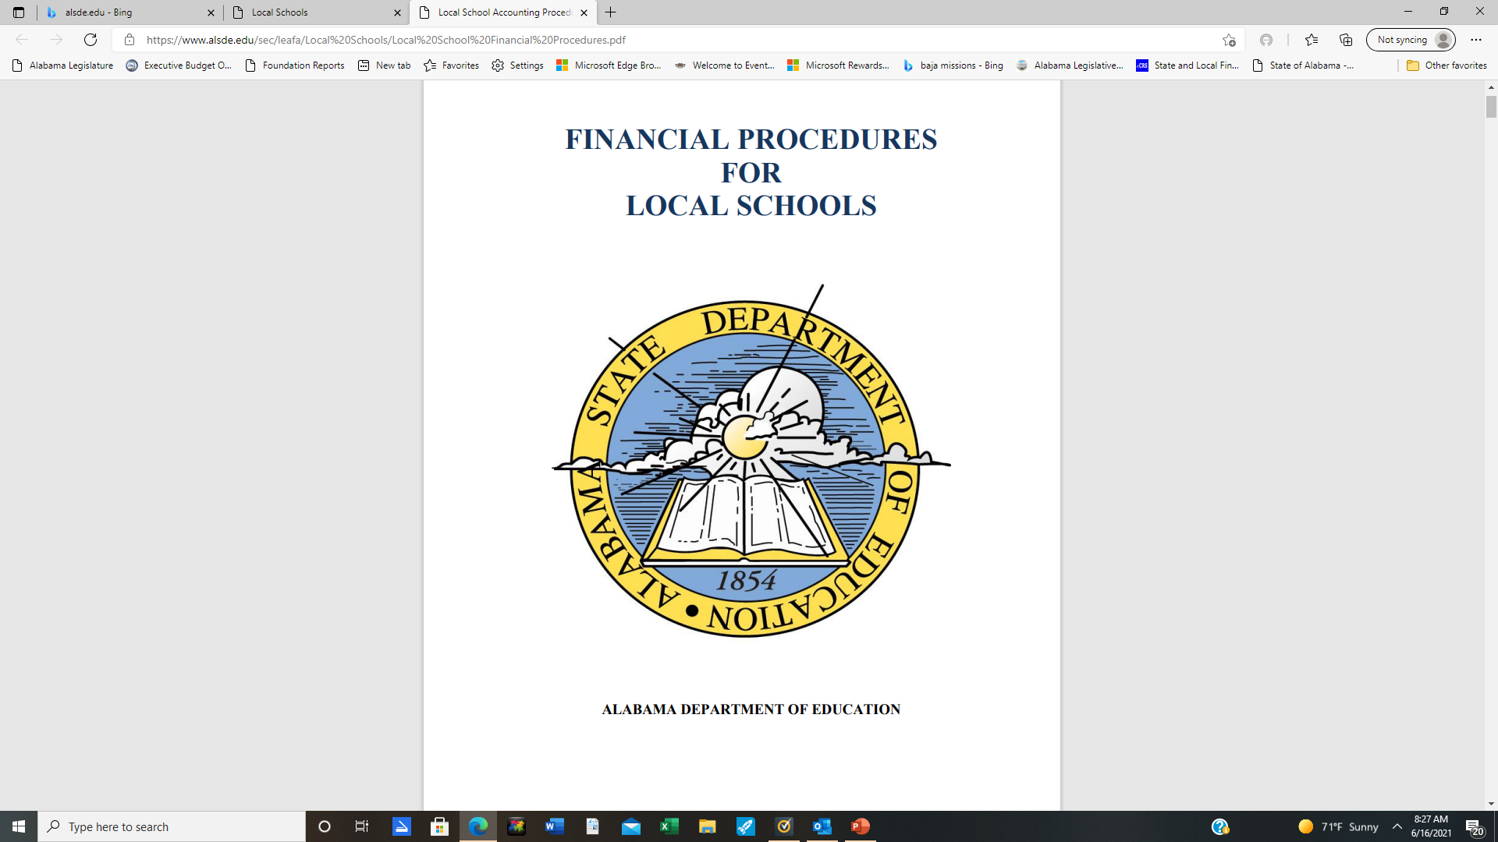
Local School Accounting Procedures (alsde.edu)

Slide 115
Local School Financial Policies
  The principalship carries with it the full responsibility for all financial matters relating to the school.
  District must ensure that principals must be familiar with all policies of the BOE so he/she will not permit practices which are contrary to policy.
  District has to provide financial training and reinforce the significance of financial compliance.

Slide 116
Staff Development
Each district is encouraged to require/provide training for key finance personnel.
  Business Office
  Local School Bookkeepers
  Principals
  Administrative Staff

Slide 117
Recommended Parent Organization Guidelines
  All officers should go through annual orientation with CSFO/ Superintendent's designee.
  School principal or designee should sit in on all meetings.
  Minutes should be maintained for all meetings.
  A budget should be submitted annually.

Slide 118
Questions??????

Slide 119
Sources:
“ Best Practices in School Budgeting, Government Finance Officers Association, January 2015
“ What You Should Know About Your School District's Finances,” Dean Michael Mead
“ Recommended Budget Practices,” National Advisory Council on State and Local Budgeting, GFOA

Slide 120
Superintendent’s Finance Training
June 2023
David Smith
Executive Director
Alabama Association of School Business Officials
Office 256-585-1511
Cell 256-426-2897
david@aasbo.com

